Slide 1
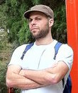

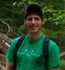


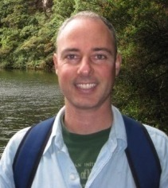
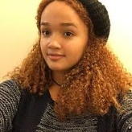
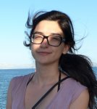
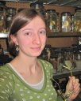
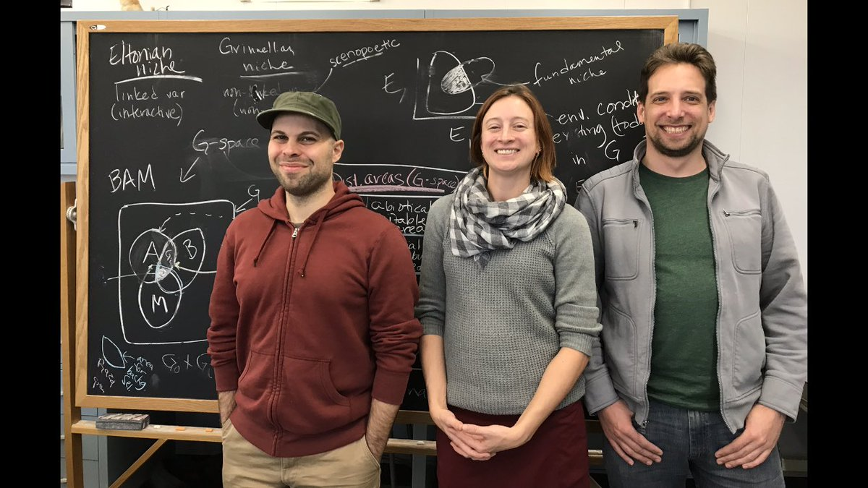
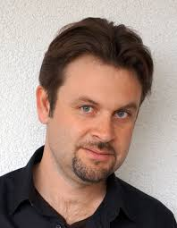
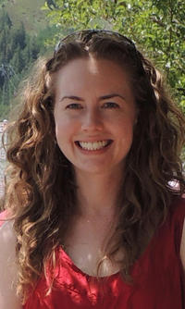

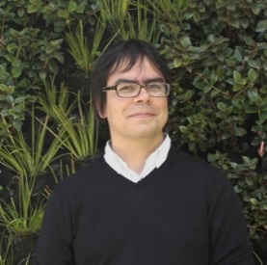
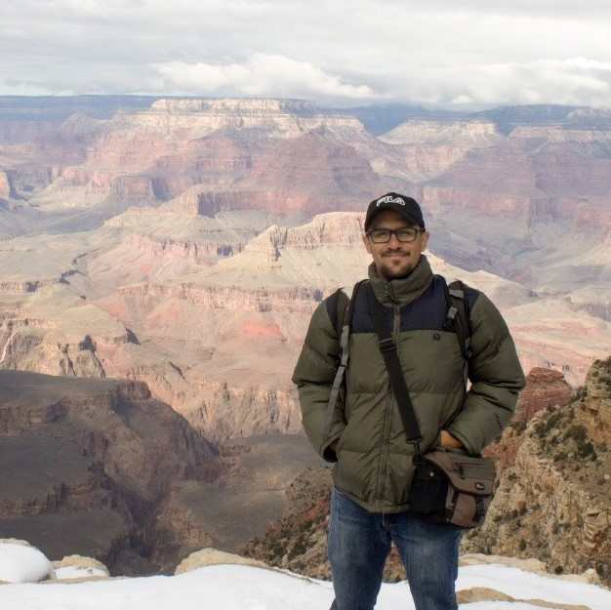
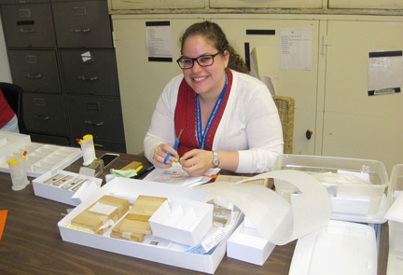
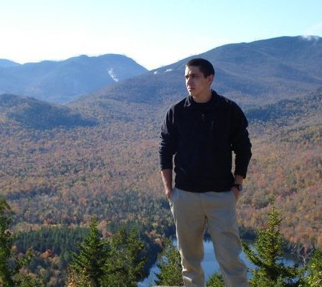
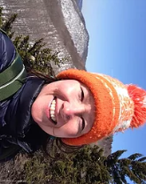
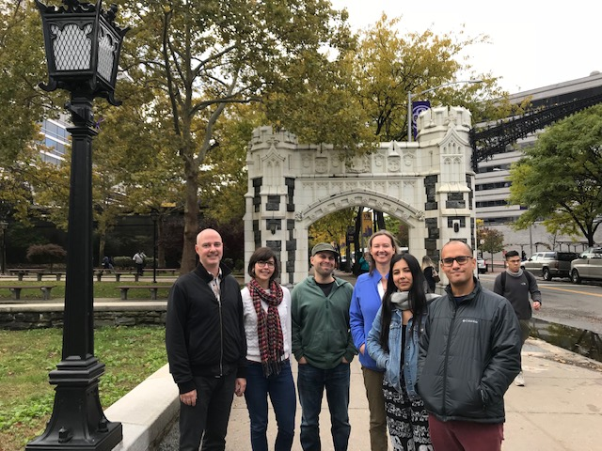
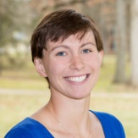
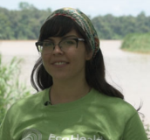





Wallace: A flexible platform for reproducible modeling of species niches and distributions built for community expansion
Jamie M. Kass, Bruno Vilela, Matthew E. Aiello-Lammens, Robert Muscarella, Cory Merow & Robert P. Anderson …
… and Jenna Rios, Sara Varela, Hannah L., Owens, Brian S. Maintner, Olivier Broennimann, Mary E. Blair, Ned Horning, Jorge Velásquez-Tibatá, Gonzalo E. Pinilla-Buitrago, Beth E. Gerstner, Peter J. Galante, Sarah I. Meenan, Valentina Grisales-Betancur, Cecina Babich-Morrow, Erica E. Johnson …
…
and many collaborating institutions!
Wallace v1 overview presentation, CC BY SA license, 10 December 2018

Slide 2




Range estimates needed

Slide 3
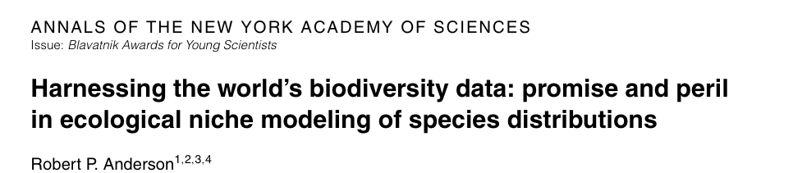
Applied biodiversity informatics
Anderson (2012)
Agenda: Making data and modeling ready to address critical environmental issues of the 21st century

Slide 4
Agenda: applied biodiversity informatics
1. High-quality data, ready to be accessed when the particular problem presents itself
2. Software that achieves an appropriate balance between automation and supervision
3. Scientists capable of building, applying, and appraising high-quality models

Slide 5
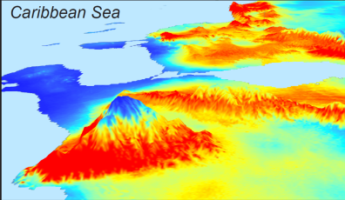
Correlative modeling of species niches and ranges
Occurrence records
Suitable areas
Model of niche
Algorithm
Environmental data

Slide 6
Correlative modeling of species niches and ranges
another place
Occurrence records
Suitable areas
Model of niche
Algorithm
Environmental data
another time
Conservation, invasive species, zoonotic diseases, climate change

Slide 7
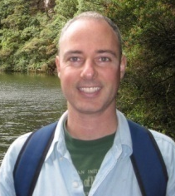
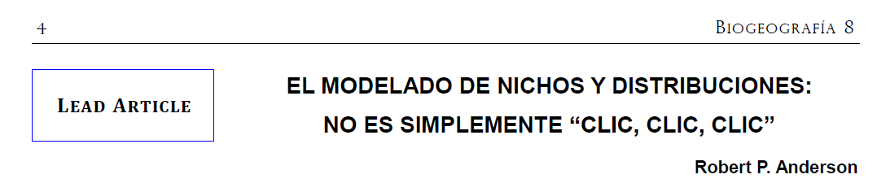
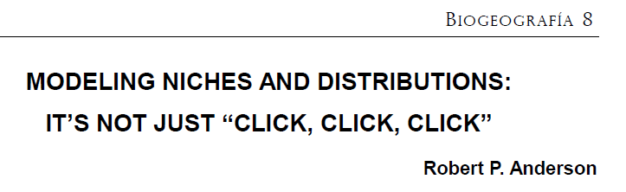
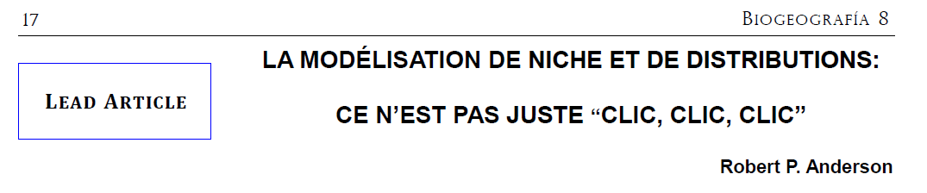
Anderson (2015)

Slide 8
Agenda: applied biodiversity informatics
Anderson (2012)
Software that achieves an appropriate balance between automation and supervision
automates repetitive aspects
forces user to make critical biological and conceptual decisions
general with respect to algorithms used

Slide 9
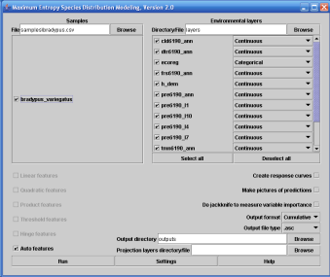
Problems with existing analyses
Existing GUIs
(too) easy
default settings
inflexible
infrequently updated
strings of applications

Slide 10
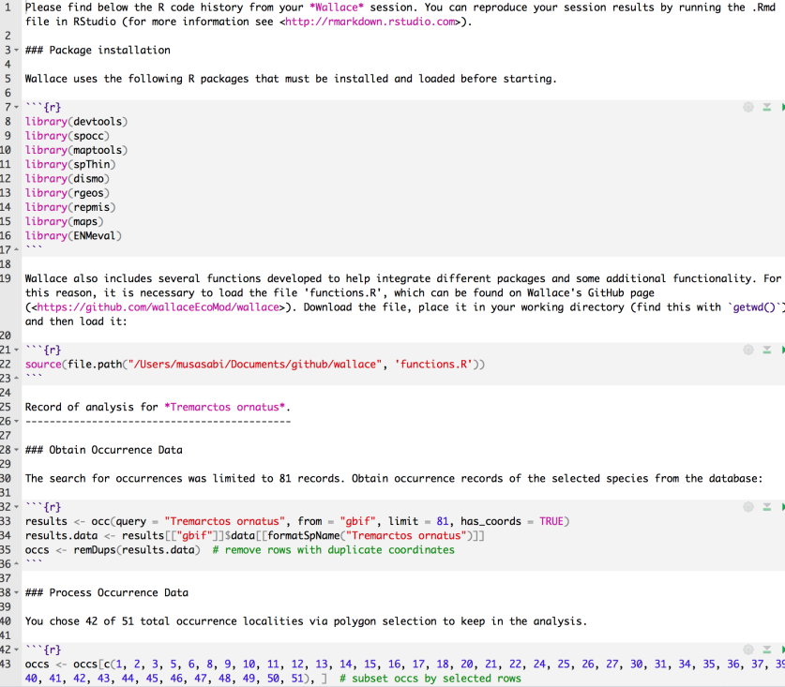
Problems with existing analyses
Existing GUIs
(too) easy
default settings
inflexible
infrequently updated
strings of applications
Code
error-prone
not easily generalizable
slow to be taken up

Slide 11
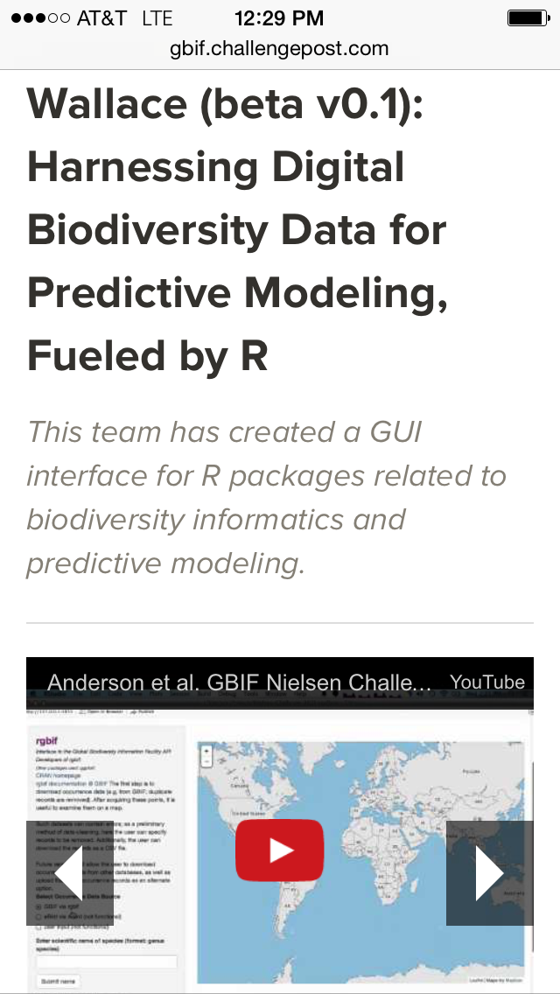
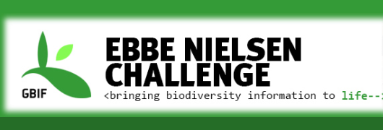
From R to a web app
Innovative use of GBIF occurrence data

Slide 12

Combine code-based methods with GUI
Foreground:
Flexible, interactive, expandable GUI
Background:
R code from new packages: reproducible

Slide 13
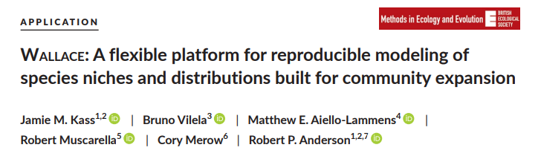







Slide 14

Wallace: currently under expansion …
Jamie M. Kass, Bruno Vilela, Matthew E. Aiello-Lammens, Robert Muscarella, Cory Merow & Robert P. Anderson
… and Jenna Rios, Sara Varela, Hannah L., Owens, Brian S. Maintner, Olivier Broennimann, Mary E. Blair, Ned Horning, Jorge Velásquez-Tibatá, Gonzalo E. Pinilla-Buitrago, Beth E. Gerstner, Peter J. Galante, Sarah I. Meenan, Valentina Grisales-Betancur, Cecina Babich-Morrow, Erica E. Johnson …
…

Slide 15
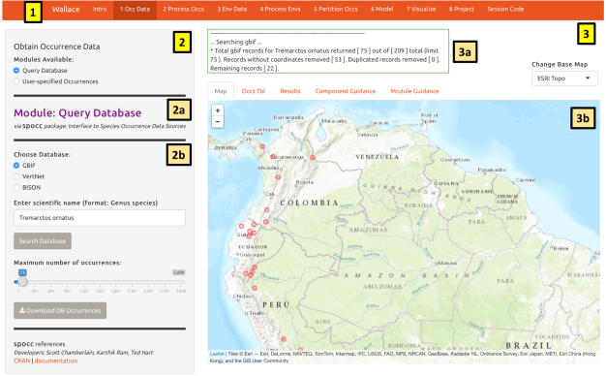
What is Wallace?
Point-and-click (GUI) application that includes most steps of a niche/distribution modeling workflow
Harnesses R packages and gives credit to their authors

Slide 16
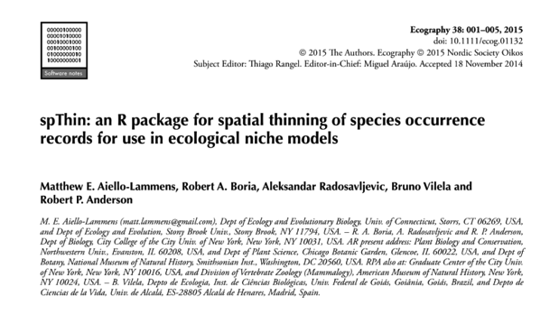

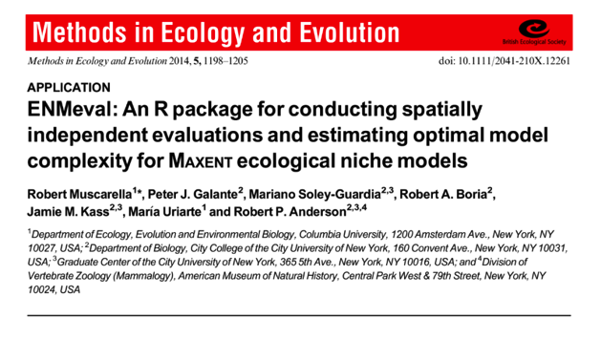

R packages on the inside

Slide 17

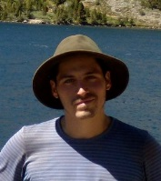
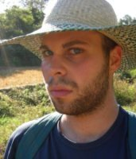


… and now many other contributors

Slide 18

Wallace

Slide 19

Qualities of Wallace
Wallace’s code is free and open
(& users can download data from online databases.)

Slide 20
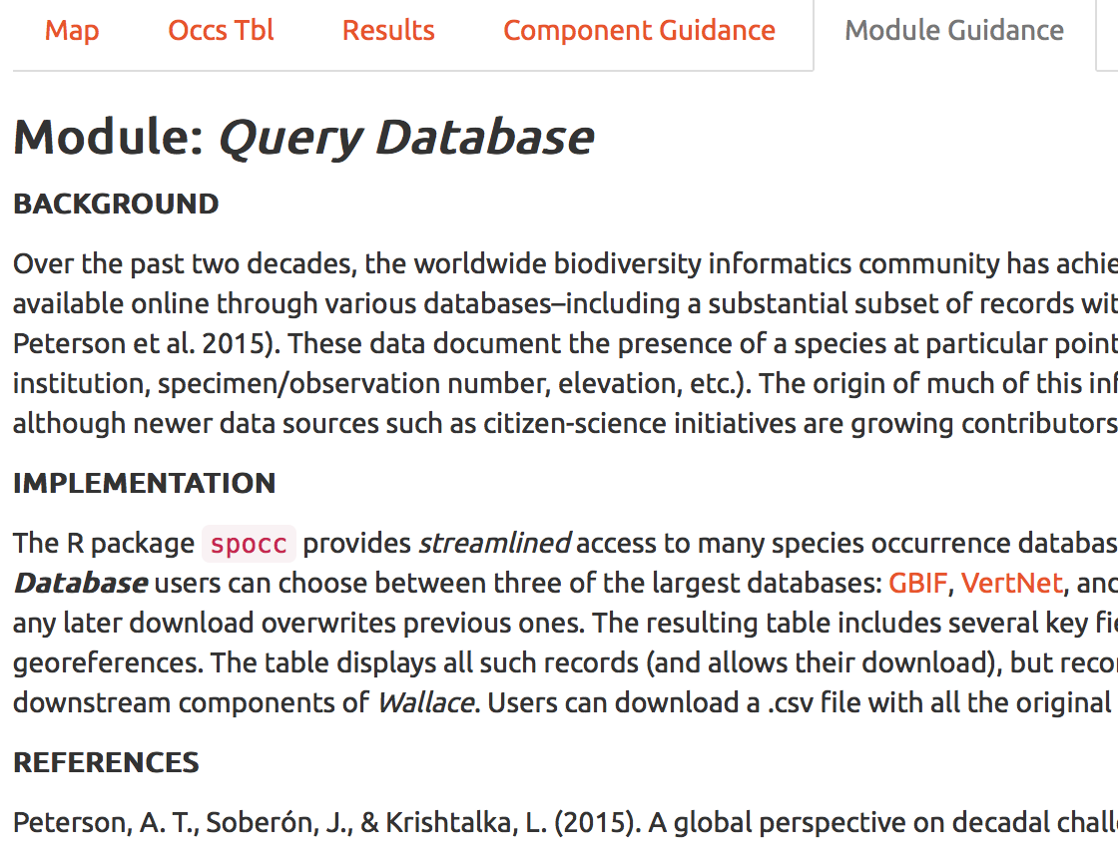
Qualities of Wallace
Wallace provides guidance
that addresses conceptual and methodological issues.

Slide 21
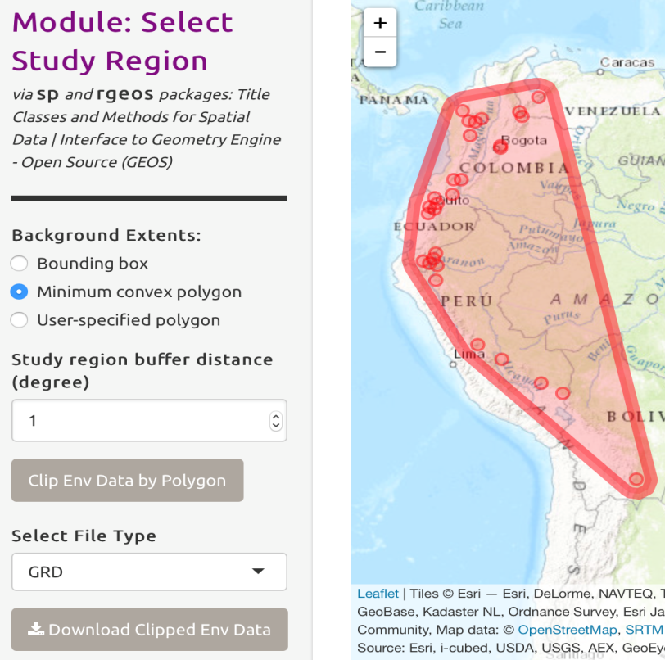
Qualities of Wallace
Wallace is flexible
by providing multiple options, and allowing user inputs and downloads for most components.

Slide 22
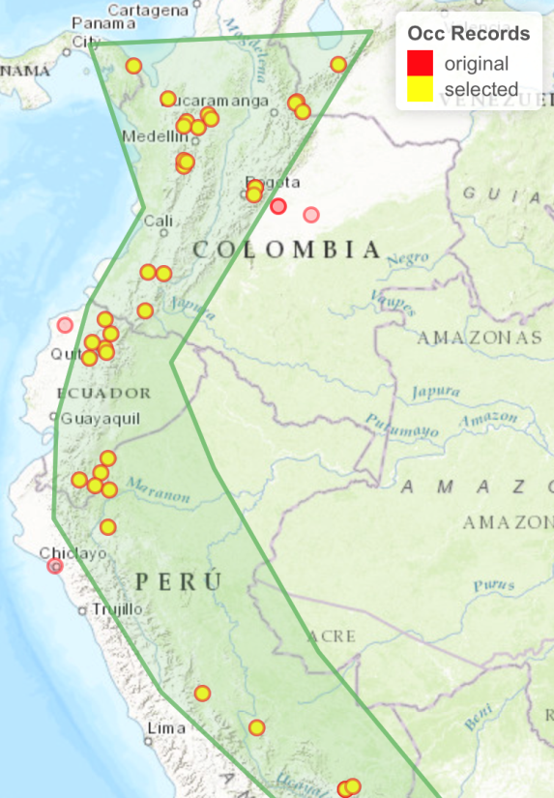
Qualities of Wallace
Wallace features interactive
maps, tables, and graphs to explore data and model predictions.

Slide 23
Qualities of Wallace
Wallace is reproducible
by providing executable code for documenting and rerunning the analysis.

Slide 24
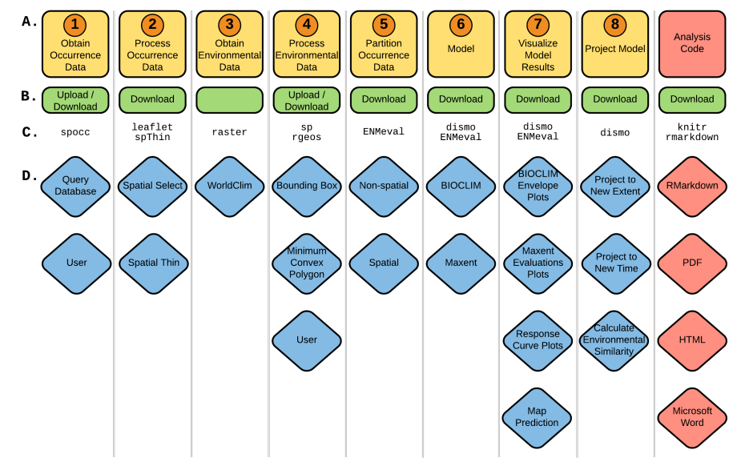
Qualities of Wallace
Wallace is expandable!
by featuring different methodological options (modules) that researchers can contribute to advance functionality.

Slide 25


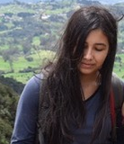

Wallace: software for niche/distribution modeling
Qualities:
open
instructive
flexible
interactive
reproducible
expandable
broadening
human diversity
Female and minority-student coder-biologists
External partners, undergraduates, and interns/fellows:
Sara Varela, Hannah L. Owens, Cecina Babich-Morrow, Jenna Rios, Sarah I. Meenan, Valentina Grisales-Betancur

Slide 26
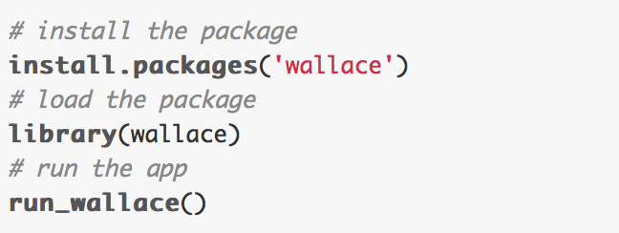
Installing Wallace
Install R and (optionally) Rstudio
For Maxent java version, install maxent.jar (https://biodiversityinformatics.amnh.org/open_source/maxent/ and appropriate Java version for your system, then place maxent.jar in dismo folder
Install the wallace package from CRAN
Troubleshooting on Github page (https://github.com/wallaceEcoMod/wallace)

Slide 27
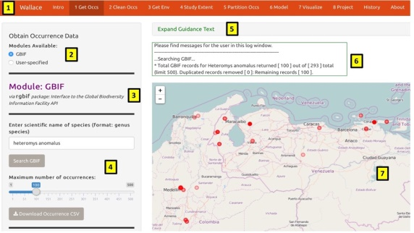


Wallace today
1. Full Release 1.0.6 (Kass et al. 2018, Methods in Ecology & Evolution software note; Google group; Wallace e-mail)
2. Ongoing NSF funding to work with external partners to add new modules
3. Ongoing NASA funding, led by Mary Blair (AMNH), to develop new R packages and add them to Wallace and interface with BioModelos
NSF DEB-1119915 & DBI-1650241
NSF DBI-1661510
Mary E. Blair
NASA 80NSSC18K0406

Slide 28


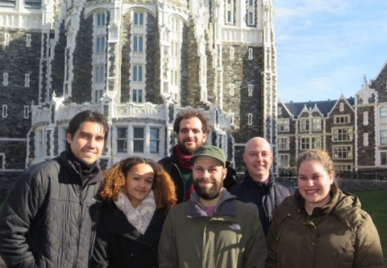
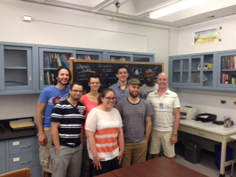

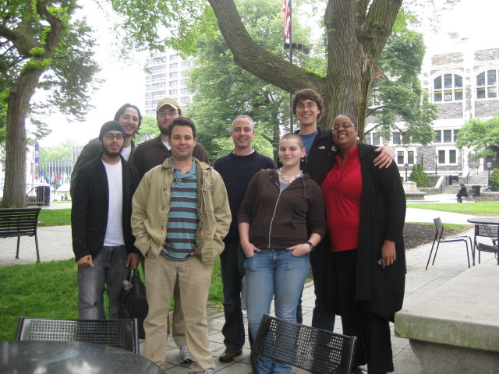

Acknowledgments
Anderson lab (chronosequence)
https://wallaceecomod.github.io/
http://www.andersonlab.ccny.cuny.edu

